Slide 1
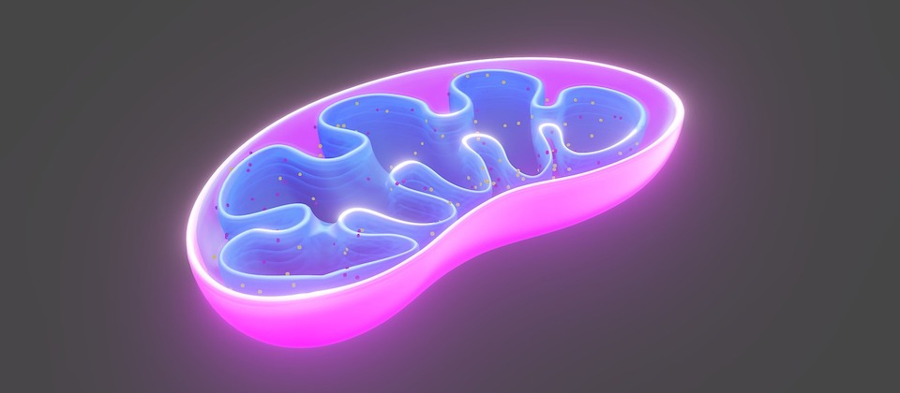
Cellular Respiration

Slide 2
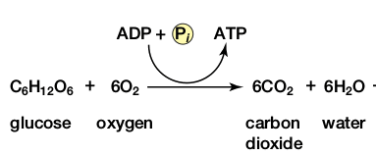
Cellular Respiration Overview
Goal: to make energy in the form of ATP
  Energy in carbs (glucose) are converted and stored in ATP
Carbohydrates are used first as a source of energy, but any food can be broken down as a source of energy
Reactants: Glucose and Oxygen
Products: Carbon Dioxide and Water
Note: Energy is released in the form of ATP but is usually NOT considered a product!

Slide 3
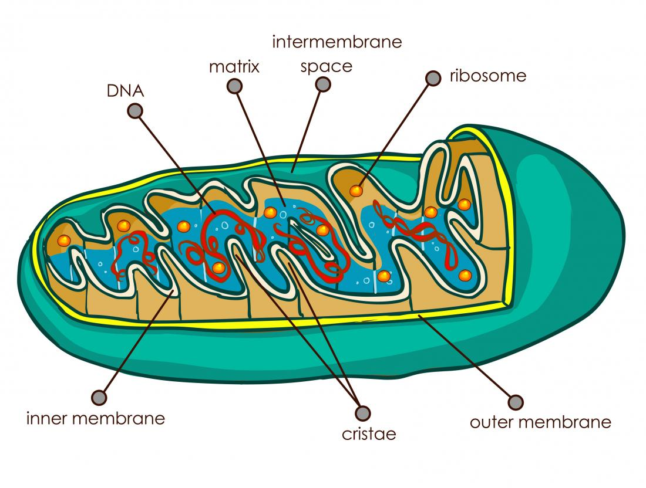
Mitochondria Structures
Double membranes: outer and inner
Inner membrane: folded membranes inside of the mitochondria
  Cristae- inner membrane folds that increase surface area to increase ATP production
Intermembrane space: fluid-filled space between membranes where H+ gradient builds
Matrix: fluid-like substance that fills the space
Contain their own DNA and Ribosomes!

Slide 4
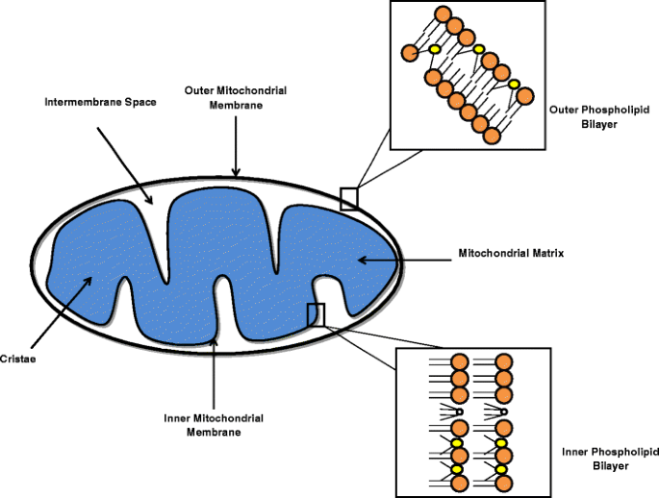
Lipid Bilayers

Slide 5
Cellular Respiration Overview
Glycolysis
Pyruvate Oxidation
Krebs Cycle
Electron Transport Chain
4 Metabolic Stages
Anaerobic Respiration
  Respiration without O2
  Occurs in Cytosol
Aerobic respiration
  Respiration with O2
  Occurs in mitochondria

Slide 6
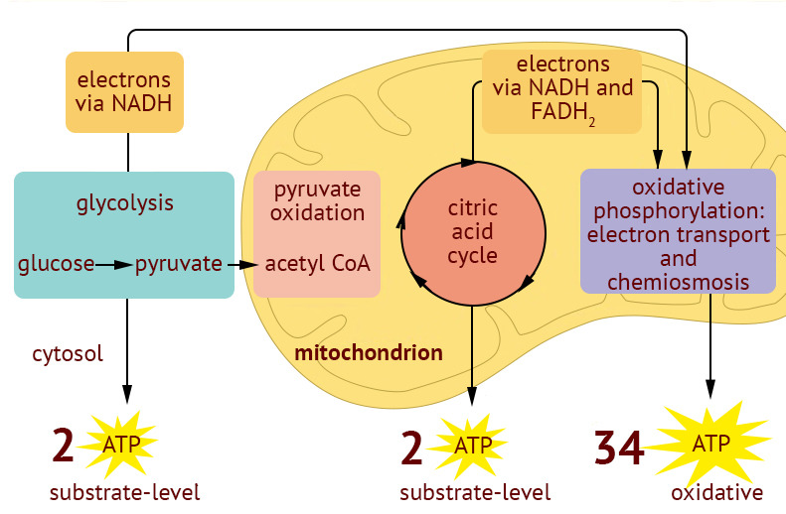
Overview of Cellular Respiration

Slide 7
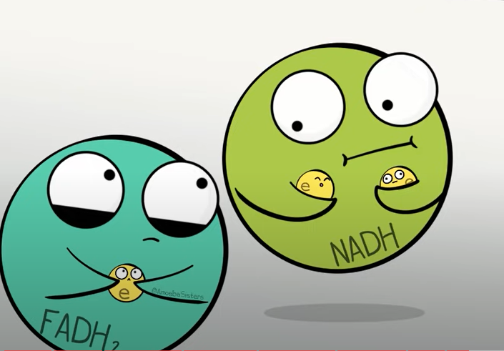
Cellular Respiration Overview
Gradual oxidation of glucose releases the energy to make ATP at each step
Electrons and hydrogens are carried down to the last step of aerobic respiration (Electron Transport Chain)
NAD+ and FAD are coenzymes that act as electron carriers for the cell and shuttle electrons to the ETC.
  NAD+ is reduced into NADH and FAD is reduced into FADH₂

Slide 8
Step 1: Glycolysis

Slide 9
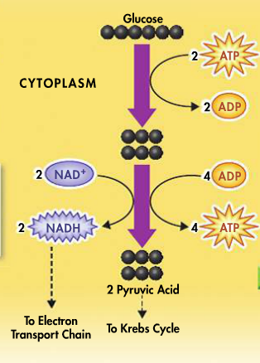
Glycolysis Overview
Glycolysis: breaking down glucose into two molecules of pyruvate
Occurs in cytosol
Anaerobic- occurs without oxygen
Inefficient: generates only 2 ATP per 1 glucose
10 step process catalyzed by enzymes

Slide 10
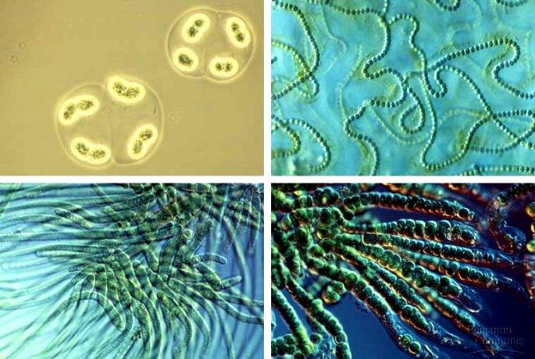
Evolutionary Perspective- Why is it Anaerobic?
Prokaryotes were the first cells (our ancestors) and had no organelles
Life first evolved without free Oxygen in the atmosphere
Prokaryotes evolved glycolysis without mitochondria
All cells use glycolysis!!

Slide 11
Steps to Glycolysis
Two phosphate groups get added to glucose (a 6 carbon molecule) from 2 ATP molecules
The phosphate groups make glucose unstable and it breaks into two 3-carbon molecules (G3P)
This 3 carbon molecule gets oxidized to make 2 NADH and 2 pyruvate are created. (4 ATP total get made in this process)

Slide 12
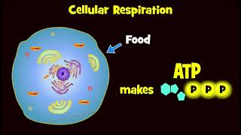
Glycolysis video- watch me!!

Slide 13
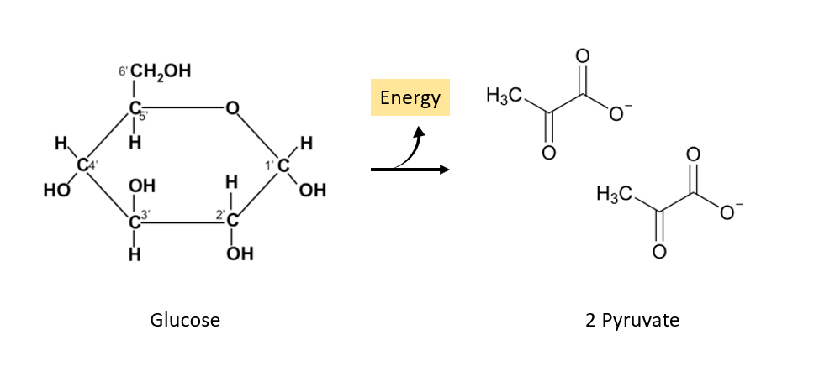
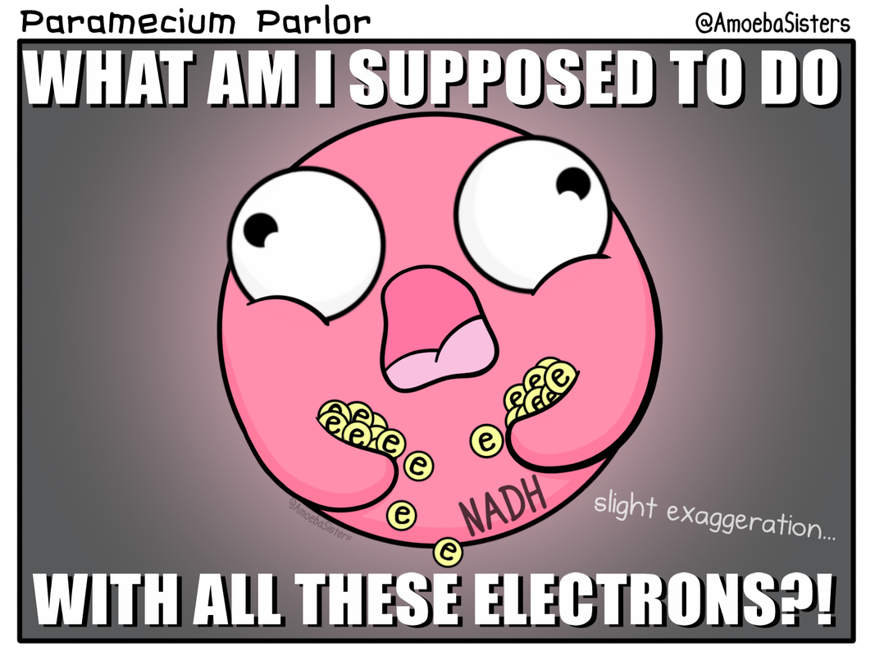
Glycolysis Summary
Converts: 1 glucose to 2 pyruvate
Produces: 4 ATP & 2 NADH
Consumes: 2 ATP
Net Yield: 2 ATP and 2 NADH
Where does the NADH go? → carries electrons and H+ down to the ETC!

Slide 14
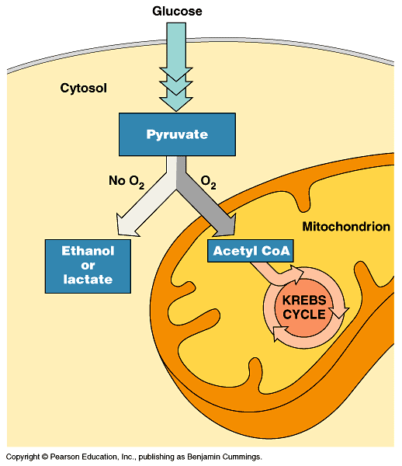
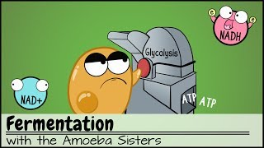
Branching Point-Decision Time!
If oxygen is present:
aerobic respiration takes place in the mitochondria
If NO oxygen present:
anaerobic respiration (fermentation) takes place in the cytoplasm
2 Types: Alcohol and Lactic Acid Fermentation

Slide 15
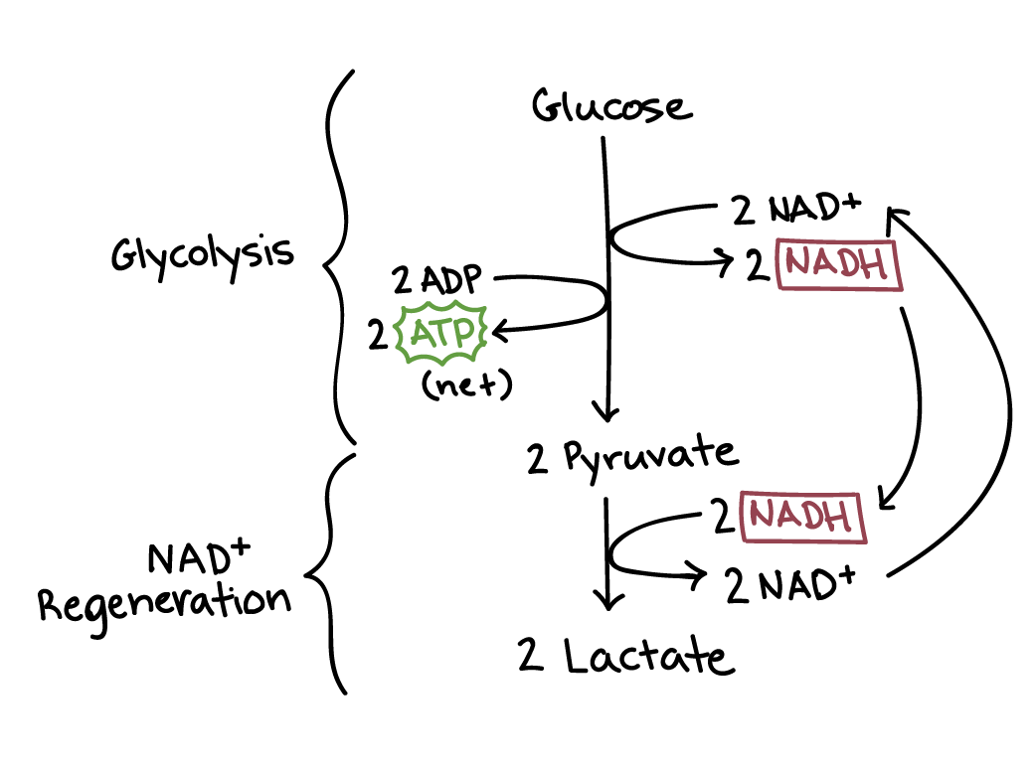
Lactic Acid Fermentation
Performed by animals and some fungi
Pyruvate is converted to lactate and 2 ATP
Significance: NADH is converted back to NAD+ to be recycled back into glycolysis (NAD+ Regeneration)
Reversible 🡪 once O2 is present again, lactate is converted back to pyruvate by the liver
In humans, this occurs when your muscles cannot get enough oxygen to keep up with demand

Slide 16

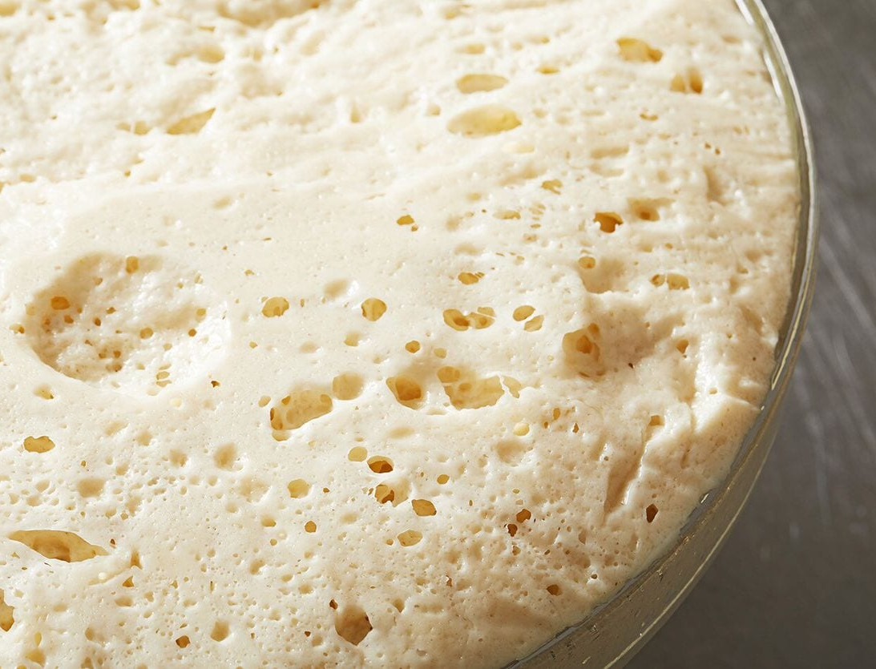
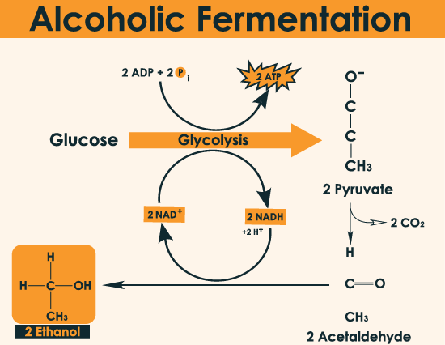
Alcohol Fermentation
Occurs in a single celled eukaryote called yeast, and in bacteria
Used commercially for baking and alcohol production
Pyruvate is converted to ethanol and CO2
  NADH is converted back into NAD+ to be used again in glycolysis
Produces only 2 ATP
Dead end process: at ~12% ethanol yeast cells die and you cannot reverse this reaction!

Slide 17
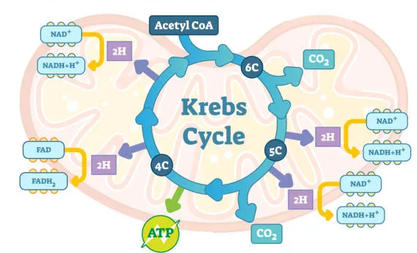
Steps 2-3:
Pyruvate Oxidation and the Krebs Cycle

Slide 18
Step 2: Oxidation of Pyruvate
Pyruvate still has energy to yield
If O₂ is available, pyruvate enters the mitochondria 🡪 specifically the mitochondrial matrix

Slide 19
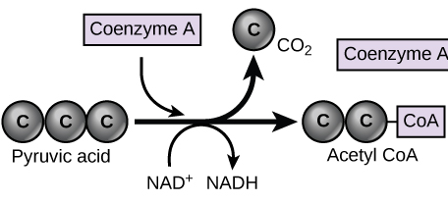
Oxidation of Pyruvate Steps
Pyruvate is converted into Acetyl Coenzyme A and CO2 (2x!)
Pyruvate loses a carbon and 2 oxygens 🡪 released as CO2 (decarboxylation)
NAD+ is reduced to NADH
Coenzyme A is transferred to pyruvate **helps bring Acetyl to Krebs Cycle
2 acetyl CoA is produced and moves on to Krebs cycle
NADH gets saved for the ETC

Slide 20
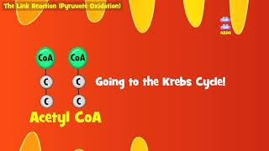
Pyruvate Oxidation Video

Slide 21
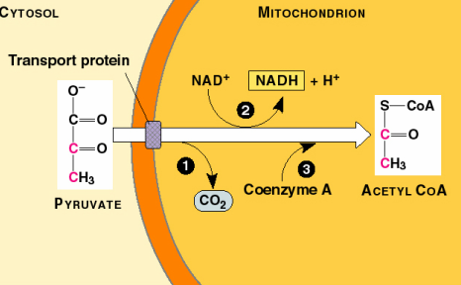
Pyruvate Oxidation in Detail
Where does CO₂ go?

Slide 22
Step 3: Krebs Cycle
AKA Citric Acid Cycle
Identified by Hans Krebs in 1937
Happens 2x per 1 glucose
Goal: Make a large amount of electron carriers for ETC
Acetyl-CoA is oxidized repeatedly in order to reduce electron carriers (NAD+ and FAD)

Slide 23
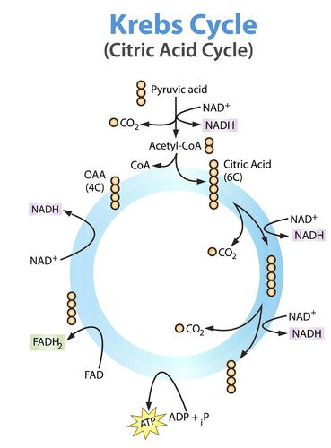
Stages of the Kreb Cycle
Acetyl-CoA is combined with Oxaloacetate to form Citric Acid and CoA is removed
Citric acid is oxidized many times and electrons are transferred to electron carriers (NAD+ and FAD)
  Carbons are also removed in this process and CO₂ is released
Molecules are rearranged to form oxaloacetate again to be continuously used in the Krebs Cycle

Slide 24
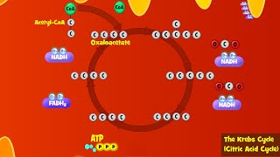
Krebs Cycle Video

Slide 25
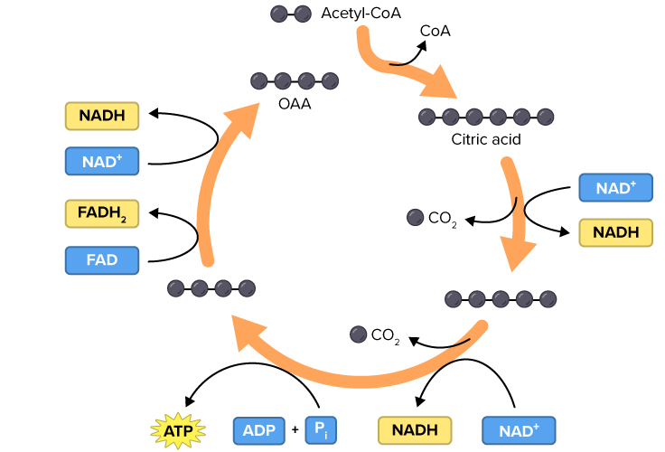
Per 1 glucose Krebs cycle spins 2x!
Oxaloacetate

Slide 26
Per 1 glucose Krebs cycle spins 2x!
← CoA removed and combines with Oxaloacetate
Oxaloacetate
← Oxidized and decarboxylated
Reduction of electron carriers →
← Reduction of electron carriers
Oxidized again →
← Oxidized and decarboxylated
← Reduction of electron carriers
ATP formation

Slide 27
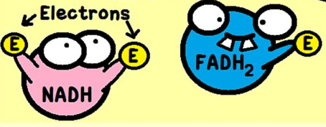
Summary of the Krebs Cycle
Spins 2x per 1 glucose
Input: 2 Acetyl CoA
Outputs:
  2 ATP
  6 NADH
  2 FADH₂
Where will NADH and FADH₂ go? To the ETC to be used to make A LOT of ATP

Slide 28
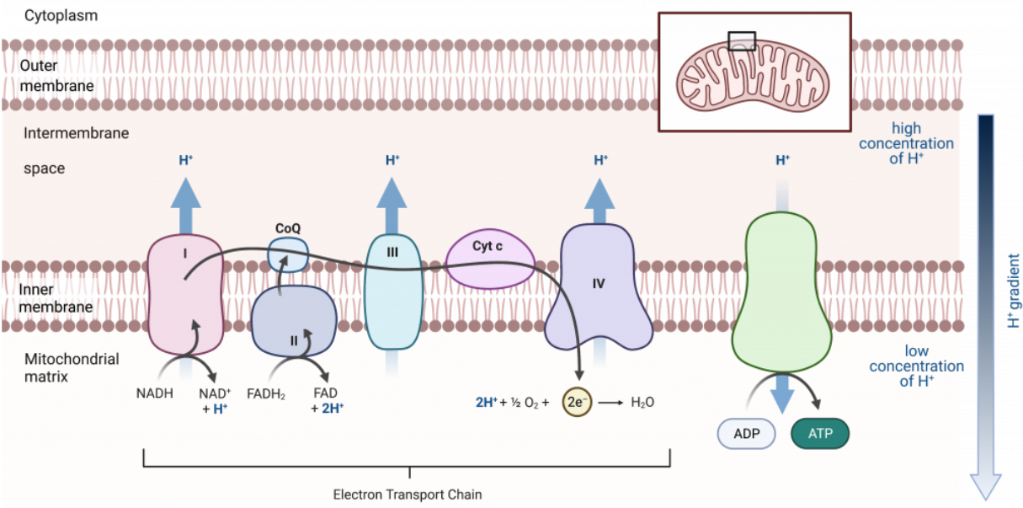
Stage 4: The ETC

Slide 29
Summary of Reactions So Far
Outputs of Steps 1-3
  ONLY 4 ATP → we need MUCH more to support multicellular organisms
  10 NADH
  2 FADH₂
We now have many stored electrons and H+ ions (protons) that we will use to power the last step!

Slide 30
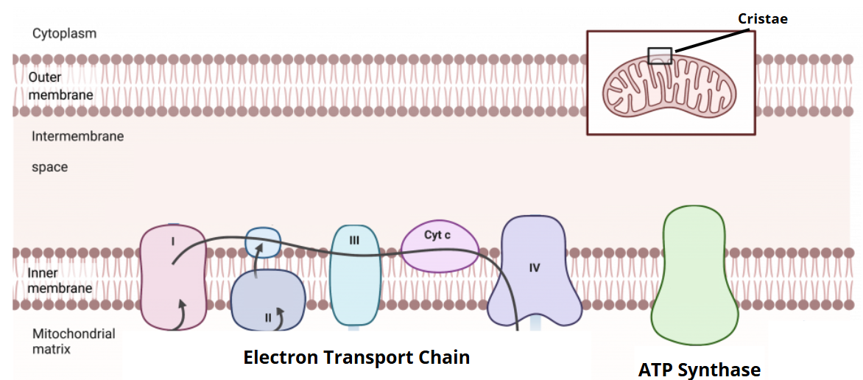
Structures of the ETC
Location of the ETC: Cristae (folds of inner membrane)
Electron transport chain: series of protein complexes that move electrons and pump H+ ions from the matrix to the intermembrane space
ATP Synthase: an enzyme that generates ATP

Slide 31
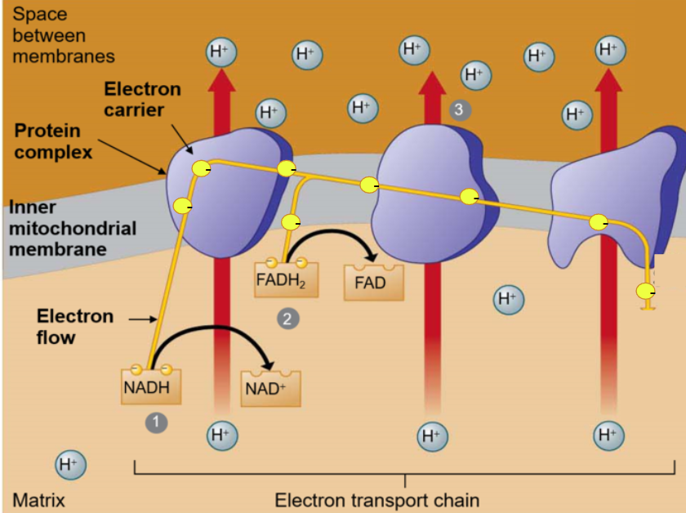
Stage 1: Building a Proton Gradient
H atoms are removed from the electron carriers NADH and FADH2 (oxidation)
  NAD+ and FAD can be recycled into previous steps!
Electrons delivered to the first protein in the ETC
Electrons move from one protein to the next along the inner membrane and energy is released. These proteins pump H+ (protons) from matrix into intermembrane space to create a H+ gradient

Slide 32
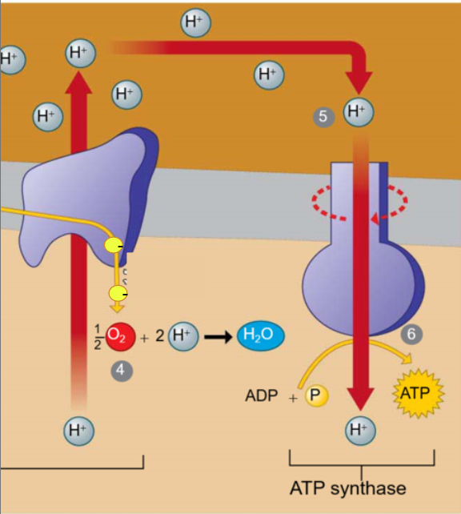
Stage 2: Oxidative Phosphorylation
H+ diffuses back into the matrix through ATP synthase which spins like a turbine to phosphorylate ADP to ATP
H+ and e- are reunited and combine with O₂ to make H2O (O₂ is the “final electron acceptor”)
  Electrons (e-) are “pulled” down the ETC because O2 is highly electronegative and strongly attracts electrons!

Slide 33
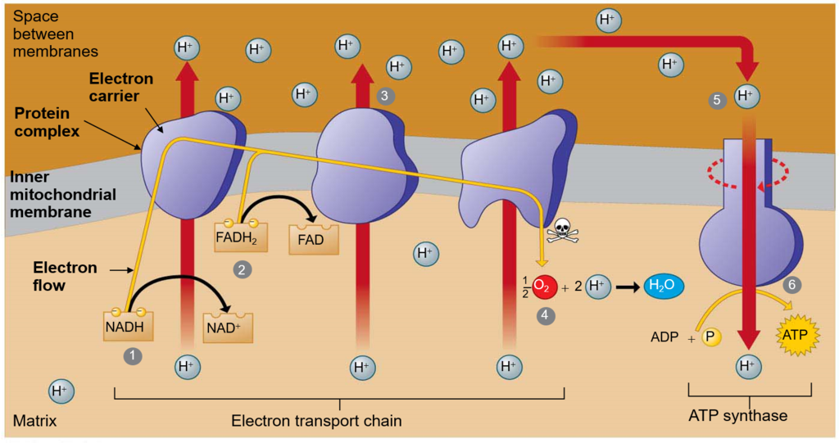
-
-
-
-
-
-
-
-

Slide 34
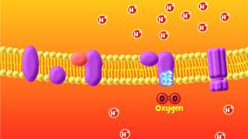
ETC Video

Slide 35
What Happens Without Oxygen?
Electrons have nowhere to go → oxygen isn’t there to accept them.
The ETC backs up with electrons.
NADH and FADH₂ can’t drop off their electrons
  The cell runs out of NAD⁺ and FAD, which are needed for glycolysis and the Krebs cycle to continue.
As a result, ATP production from the ETC stops.
What process does the cell revert to as a back to in the absence of oxygen? What is the goal of this process?

Slide 36
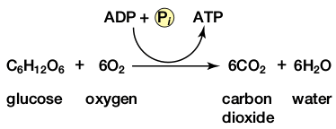
Summary of Cell Respiration
Where did the glucose come from?
Where did the O2 come from?
Where did the CO2 come from?
Where did the CO2 go?
Where did the H2O come from?
Where did the ATP come from?
What else is produced that is not listed
in this equation?
Why do we breathe?

Slide 37
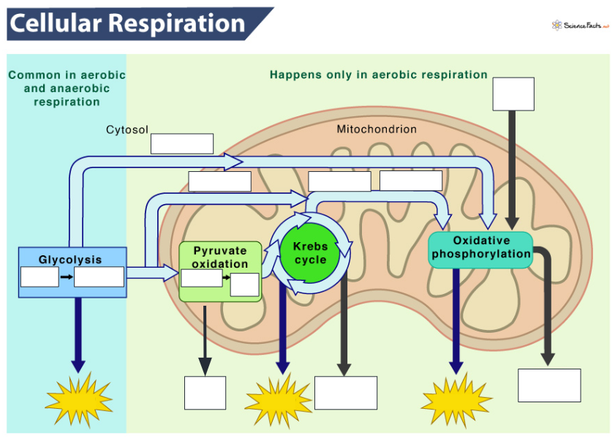
Let’s summarize the outputs below!

Slide 38
